Slide 1
Files and Exceptions

Slide 2
Learning Objectives
To learn how to store, modify, and access data in a text file from python program.
Recap and Recall different file paths
Understand exceptions and error handling

Slide 3
I have a problem…
I have many dinner items for weasley and noche,

Slide 4
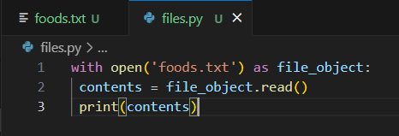
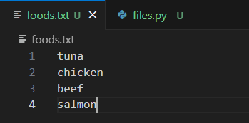
Text Files
To solve my problem, I could store my data in a text file and access the contents through my code. Kind of like a ‘database’. I could read from an entire text file like the example below. There is a lot going on here though so let’s break it down.
Notes:
Foods.txt
tuna
chicken
beef
salmon
files.py
with open('foods.txt') as file_object:
contents = file_object.read()
print(contents)

Slide 5
open() function
To do anything with a function, you first need to open it! Even if it is something as simple as printing it.
The open() function only requires one argument: what you want to open!
Python looks for this file in the directory where the program that’s currently being executed is stored. So make sure you save both .py and .txt files in the same directory*!
Notes:
Also mention ‘as file_object’

Slide 6
read() method
The read() method is exactly what it sounds like! It allows us to read the entire contents of our file.

Slide 7
Simple, right? But what if I want to store my text file in another directory?

Slide 8
Files Paths
Recap and Recall: what are the two file paths that we learned in Linux?
Skip this slide unless Linux has been covered first.
Notes:
Relative file paths and absolute file paths

Slide 9
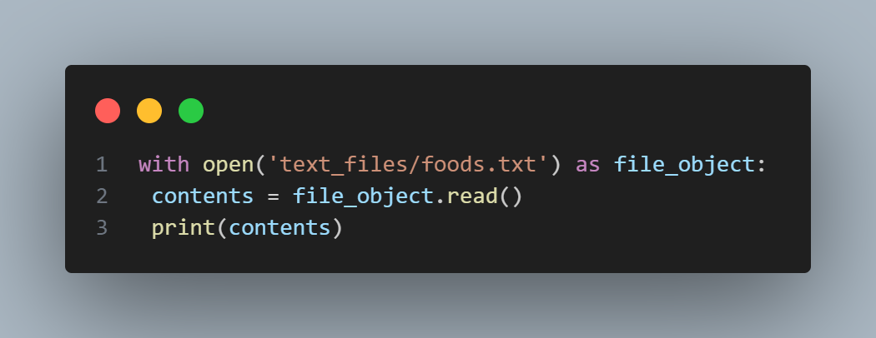

Relative File Paths
A relative file path tells Python to look for a given location relative to the directory where the currently running program file is stored. Depending on the OS, you will need to change the slashes!
Linux/MacOS: Windows:

Slide 10
Absolute Path
You can tell Python the exact path to get to your file, no matter where your file is being stored.
Use this if your relative path does not work!
Like with the relative path, there are some differences between OS.
This concept is also important in Linux, so we will revisit it.

Slide 11
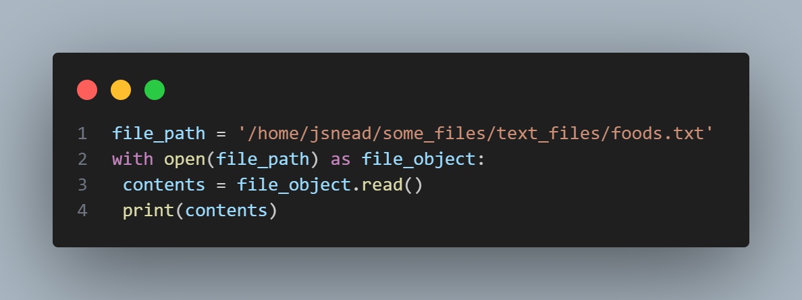
Linux/MacOS

Slide 12
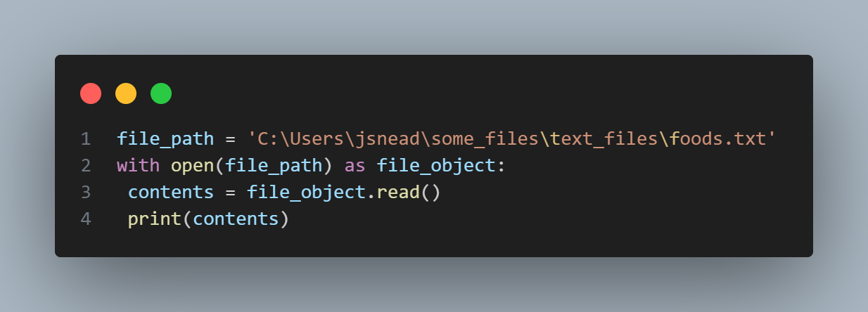
Windows

Slide 13

Reading Line by Line
Sometimes we might want to read certain lines of a file, or search for specific within a file. We might even want to modify our file in some way… But how?! What power do we wield with our file?

Slide 14
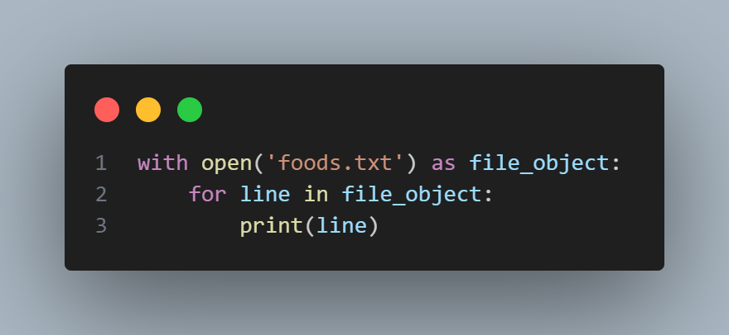
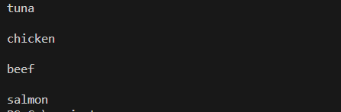
Line By Line
Notes:
with open('foods.txt') as file_object:
for line in file_object:
print(line.rstrip())
Also mention rstrip

Slide 15
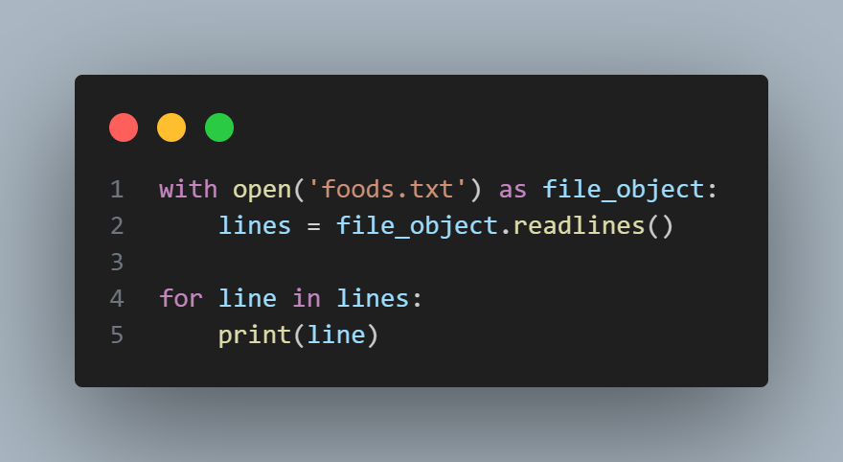
Making Lists from our File
When you use ‘with’, the file content returned by open() is only available inside the ‘with block’ that contains it. If you want to have access to the content outside of the with block, you can store it in a list then work with this list in the rest of the program.
Notes:
with open('foods.txt') as file_object:
lines = file_object.readlines()
for line in lines:
print(line)
#store in text file.
foods .txt
tuna
chicken
beef
salmon

Slide 16
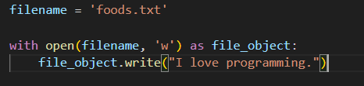
Writing to an Empty File
Notes:
filename = 'foods.txt'
with open(filename, 'w') as file_object:
file_object.write("I love programming.")
Mode sample codes:
# Using 'a' mode (Append mode)
filename = 'foods.txt'
with open(filename, 'a') as file_object:
file_object.write("\nNoche loves cheese")
ANOTHER EXAMPLE
filename = 'foods.txt'
with open(filename, 'a') as file_object:
file_object.write("Today I have tuna and salmon.\n")
file_object.write("I love making dinner for the cats.\n")
# Using 'r' mode (Read mode)
filename = 'foods.txt'
with open(filename, 'r') as file_object:
content = file_object.read()
print("Content of the file:")
print(content)
# Using 'r+' mode (Read/write mode)
filename = 'foods.txt'
with open(filename, 'r+') as file_object:
content = file_object.read()
print("\nContent of the file after appending:")
print(content)
file_object.write("\nWeasley enjoys cheese too")
# Using 'a+' mode (Append/read mode)
filename = 'foods.txt'
with open(filename, 'a+') as file_object:
file_object.write("\nThe cats cannot eat cheese since cats are lactose intolerant")
file_object.seek(0) # Move the file pointer to the beginning
updated_content = file_object.read()
print("\nContent of the file after another append:")
print(updated_content)

Slide 17
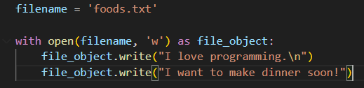
Writing Multiple Lines
Notes:
filename = 'foods.txt'
with open(filename, 'w') as file_object:
file_object.write("I love programming.")
file_object.write("I want to make dinner soon!")
#with new line
filename = 'foods.txt'
with open(filename, 'w') as file_object:
file_object.write("I love programming.\n")
file_object.write("I want to make dinner soon!")

Slide 18
Exceptions
Exceptions are errors from which your code cannot recover.
You have probably seen a lot of these in the past, and a couple were mentioned in our earliest Python sessions! Can you remember any?

Slide 19
Types of Exceptions
TypeError: Raised when an operation or function is applied to an object of inappropriate type.
FileNotFoundError: Raised when a file or directory is requested but cannot be found.
ZeroDivisionError: Raised when division or modulo operation is performed with zero as the divisor.
SyntaxError: Raised when the Python parser encounters a syntax error, such as incorrect indentation or invalid syntax.
IndentationError: Raised when there is incorrect indentation in the code.
There are many more, but these are just a few!
Notes:
TypeError example:
# Adding integer and string
result = 5 + "hello"
FileNotFOundError:
# Trying to open a non-existent file
file = open("nonexistent.txt", "r")
ZeroDivisionError:
# Division by zero
result = 5 / 0
SyntaxError:
# Missing colon
if True
print("Hello")
IndentationError:
# Incorrect indentation
def my_function():
print("Hello")

Slide 20
Handling Exceptions -try-except blocks
Exceptions are handled with try-except blocks. A try-except block asks Python to do something, but it also tells Python what to do if an exception is raised.
When you use try-except blocks, your programs will continue running even if things start to go wrong. Instead of tracebacks, which can be confusing for users to read, users will see friendly error messages that you write.

Slide 21
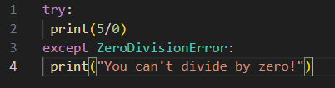
Using try-except blocks
When you think an error may occur, you can write a try-except block to handle the exception that might be raised. You tell Python to try running some code, and you tell it what to do if the code results in a particular kind of exception.
Notes:
try:
print(5/0)
except ZeroDivisionError:
print("You can't divide by zero!")

Slide 22
Tips when handling exceptions
Be specific in exception handling
Print meaningful error messages
Keep exception handling simple
Test exception handling

Slide 23
Storing Data
Sometimes you may want to ask users to input certain kinds of information, then you may want to store this information in data structures like lists and dictionaries. When the users close the program, you may want this data to persist. A simple way to do this is storing your data in a json module.

Slide 24
json modules
The json module allows you to dump simple Python data structures into a file and load the data from that file the next time the program runs. This data can also be used across different Python programs!

Slide 25
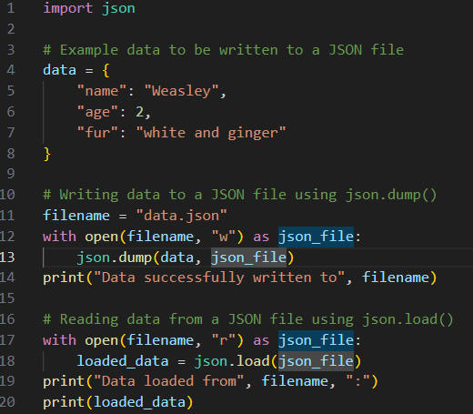
json.dump() and json.load()
Notes:
import json
# Example data to be written to a JSON file
data = {
"name": "Weasley",
"age": 2,
"fur": "white and ginger"
}
# Writing data to a JSON file using json.dump()
filename = "data.json"
with open(filename, "w") as json_file:
json.dump(data, json_file)
print("Data successfully written to", filename)
# Reading data from a JSON file using json.load()
with open(filename, "r") as json_file:
loaded_data = json.load(json_file)
print("Data loaded from", filename, ":")
print(loaded_data)

Slide 26
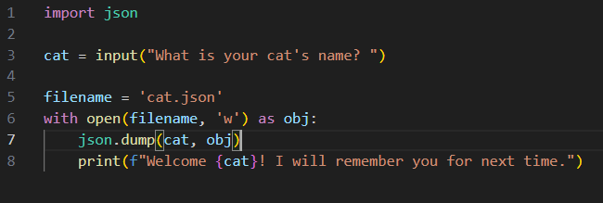
User Generated Data
Notes:
import json
cat = input("What is your cat's name? ")
filename = 'cat.json'
with open(filename, 'w') as obj:
json.dump(cat, obj)
print(f"Welcome {cat}! I will remember you for next time.")

Slide 27
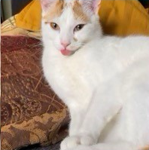
Well done! Now move on to the exercises!

